Slide 1
One Web Approach
Designing for the future

Slide 2
What is One Web Approach?

Slide 3
One Web Approach Is
Originally coined by Tim Berners-Lee in this article: http://www.scientificamerican.com/article/long-live-the-web/
Same information and services available to users irrespective of the device they are using.
Does NOT mean that exactly the same information is available in exactly the same representation across all devices.

Slide 4
How do we build this?

Slide 5
One Digital Architecture (1DA)

Slide 6
One Digital Architecture
Separate business services from existing UIs and build new client side UIs.
Backend only responsible for providing the data
Frontend changes not dependent on the backend, only when new data needs to be sent will the backend change
Take adaptive further - a service centric platform and universal client.
Build Omni-channel technology foundation. All channels are equal.

Slide 7
1DA Design Implications

Slide 8
Feature Detection Over Device Detection
Linear resolution breakpoints
No overlap of view resolutions
Functional Flexibility
Frontend functional changes should be easier due to no backend reliance
Turn on/off functionality (Ex. Geolocation in Store Locator only in browsers that support it)
Different interaction paradigms (Ex. Touch gesture controlled gallery on devices that support touch)
Device detection still possible but only use when necessary and not recommended
Pixel ratio detection (Pixel density)
Need to support for higher resolution devices

Slide 9
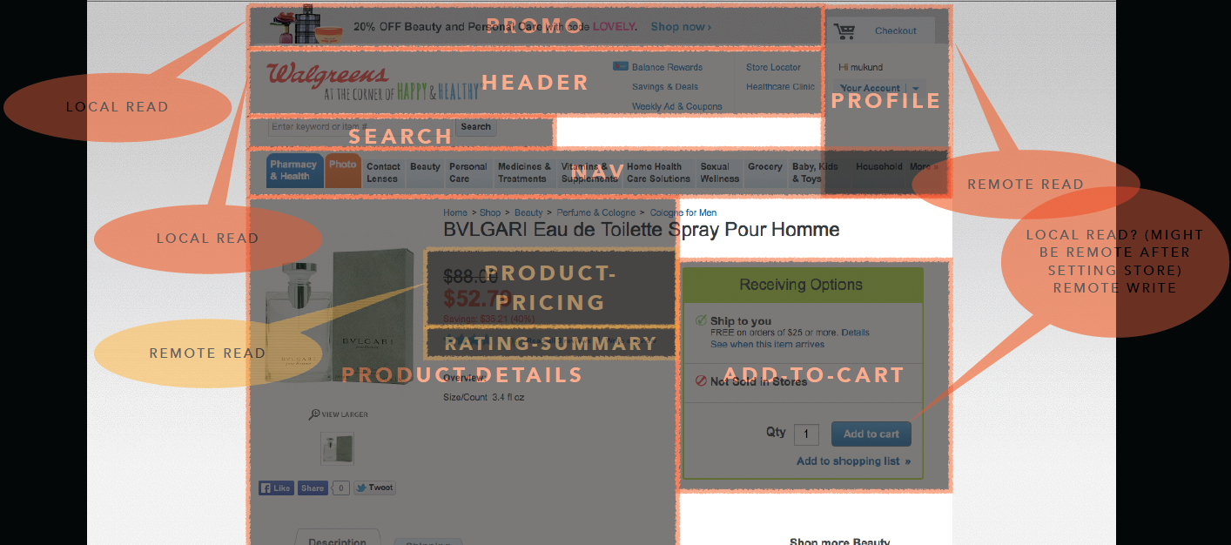
Widgets
A self-contained module with it’s own code (HTML, CSS, JavaScript)

Slide 10
How do we design this?

Slide 11
Adaptive and Beyond
“Design as a system.”
We shouldn’t strictly think about 3 separate views
We need to be aware of the potential contextual differences
BUT be aware that there is not a specific view dedicated to one device, many devices will likely be in between two breakpoints

Slide 12
Breakdown Page, Then Mobile First
1
Breakdown What We Have Now
2
Design Mobile First And Up

Slide 13
UX’s Primary Goal: Context
Determine context based on current breakpoints
Maintain Goal/Task parity
Interaction and UI patterns appropriate for context
Prioritize Information
Our 3 current contexts (based on device dimensions):
Desktop
Tablet
Phone
Imagine future contexts

Slide 14
Creative’s Primary Goal: Consistency
Develop and follow design tenets across all breakpoints
Start with smallest resolution to determine element style and then scale up
“We can design an interface that works on 1280, 960, 768, 600, 480, 320; and if the design is seamless then no one will ever notice if device sizes adapt on any specific pixel or overlap in ranges.”

Slide 15
Appendix

Slide 16
Future Contexts
Context Based on Device Dimensions
Small phone/device (240pt)
Large phone/Small Tablet (540pt)
Large Tablet (1366pt)
Small Desktop (1024pt)
Large Desktop/TV (1920pt)
Context Based on Location
In-Store
At Home
Logged-in/Logged-out
Many many more…

Slide 17
Design Tenets
Cohesive and Complimentary
Maintain goal/task parity
Experience should easily and consistently span all devices
Interaction, UI patterns, and visual styles may vary across context, but complement each other
Flexible
Percentages-based grid
Touch friendly
Flat aesthetic
ATCO

Slide 18
DRAFT: Breakpoints
320pt – 599pt
600pt – 767pt
768pt – 1140pt
* Inspired by Walmart.ca

Slide 19
DRAFT: Reference Resolutions + Canvas Size
320pt (640px X 1136px)
600pt (1200px X 2048px)
768pt (1536px X 2048px)

Slide 20
Site Inspiration With Similar Approaches
http://bradfrostweb.com/demo/mobile-first/
https://www.threadless.com/
http://www.ideeli.com/
http://www.burton.com/
http://www.walmart.ca/
* A good way to determine if a site is using client-side adaptive, turn of JavaScript in your browser.

Slide 21
References
http://www.w3.org/TR/mobile-bp/#OneWeb
http://www.webmonkey.com/2013/05/the-two-flavors-of-a-one-web-approach-responsive-vs-adaptive/
http://econsultancy.com/blog/61933-why-a-one-web-approach-is-the-way-for-ecommerce
http://www.mobilemarketer.com/cms/opinion/columns/16409.html

